Slide 1
Analyzing Amazon Sales data
Detailed Project Report
RAJAT SHARMA

Slide 2
PROJECT DETAIL
Project Title | Analysing Amazon Sales data
Technology | Business Intelligence
Domain | E- commerce
Project Difficulty level | Advanced
Programming Language Used | Python
Tools Used | Jupyter Notebook, Tableau

Slide 3
OBJECTIVE
The goal of this project is to find sales trend -> month wise, year wise and yearly month wise
To find key metrics and factors and show meaningful relationships between attributes.

Slide 4
PROBLEM STATEMENT
Sales management has gained importance to meet increasing competition and the need for improved methods of distribution to reduce cost and to increase profits. Sales management today is the most important function in a commercial and business enterprise.
Do ETL : Extract-Transform-Load some Amazon dataset and
Find Sales-trend -> month wise , year wise , yearly month wise

Slide 5
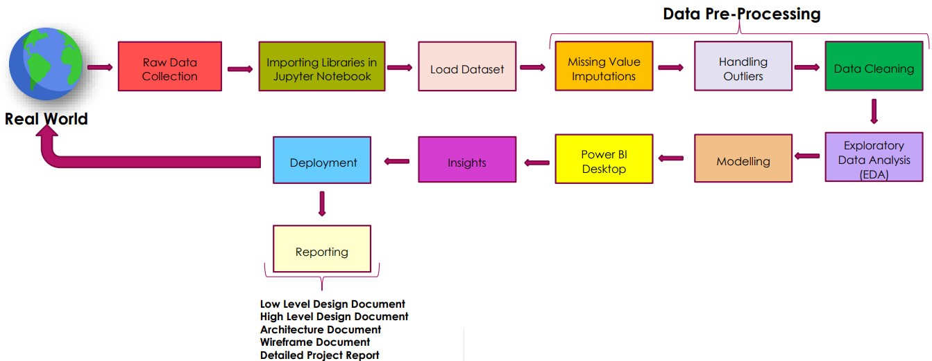
Architecture

Slide 6
DATASET INFORMATION
* Region - Gives the different regions of the sales all over the world.
* Country - The country of the sale item.
* Item type - About different item types.
* Sales Channel - There are two sales channel modes - Online and Offline
* Order Priority - Four Letters C H L M used to represent order priority.
* Order Date - The date of placing the order in mixed format. (Non uniform date formats)
* Ship Date - The shipping date of the product.
* Units Sold - Number of units of the particular item sold.
* Unit Price - Unit Price of the particular item at which it is sold.
* Unit Cost - Unit Cost i.e. per unit amount spend to make the product.
* Total Revenue - Total revenue generated for the item for the given region and country.
* Total Cost - Similarly Total cost
* Total Profit - and Total Profit

Slide 7
Detailed Description:
Following insights can be helpful to improve the sales of the company:
Unit Price - Most of the unit price is within 180 dollars value as shown by the median value. The maximum unit price can be seen 668.27 and there is not any outliers as can be seen from the box plot.
Unit Cost - Most of the unit cost is within 107 dollars as is shown by the median value. From box plots we can see here again we do not have any outliers, the maximum unit cost we have is around 525 dollars.
Total Profit -
Most of the Total Profit values is within 2.9e+05 dollars as is shown by the median value.
From the box plot we can see we have more than 3 outliers for this column
Maximum total profit appears in months Feb and Nov , and least in Mar and Aug
Also, the total profit is maximum for year 2012 and least in 2011
And maximum profit is obtained from cosmetics and minimum with food items such as Fruits, beverages and meat.

Slide 8
Units Sold -
Most of the units Sold lies within 5383 units as can be seen from the median value. From box plots we can say again here we do not have any outliers, the maximum Units Sold is 9925 units and minimum we have is 124 units.
We can see highest units sold are in Jul month followed by Feb, and least in Aug, March and Dec
Maximum units were sold at year 2012 and next at year 2014
Clothes and Cosmetics have the maximum units sold, meat is minimum
Shipping Duration - Most of the values in shipping duration is within 24 days as is shown by the median value and also the deviation or spread of data is lesser. Clearly, we do not have any outliers here, the maximum and minimum values are 50 and 0 days.

Slide 9
Item Type - Most of the item types are Clothes, Cosmetics and Office Supplies
Region - The most common regions are Sub-Saharan Africa (37) and Europe (24).
Shipping day name - Most of the shipping is happening on Saturdays and Wednesdays and least on Sundays

Slide 10

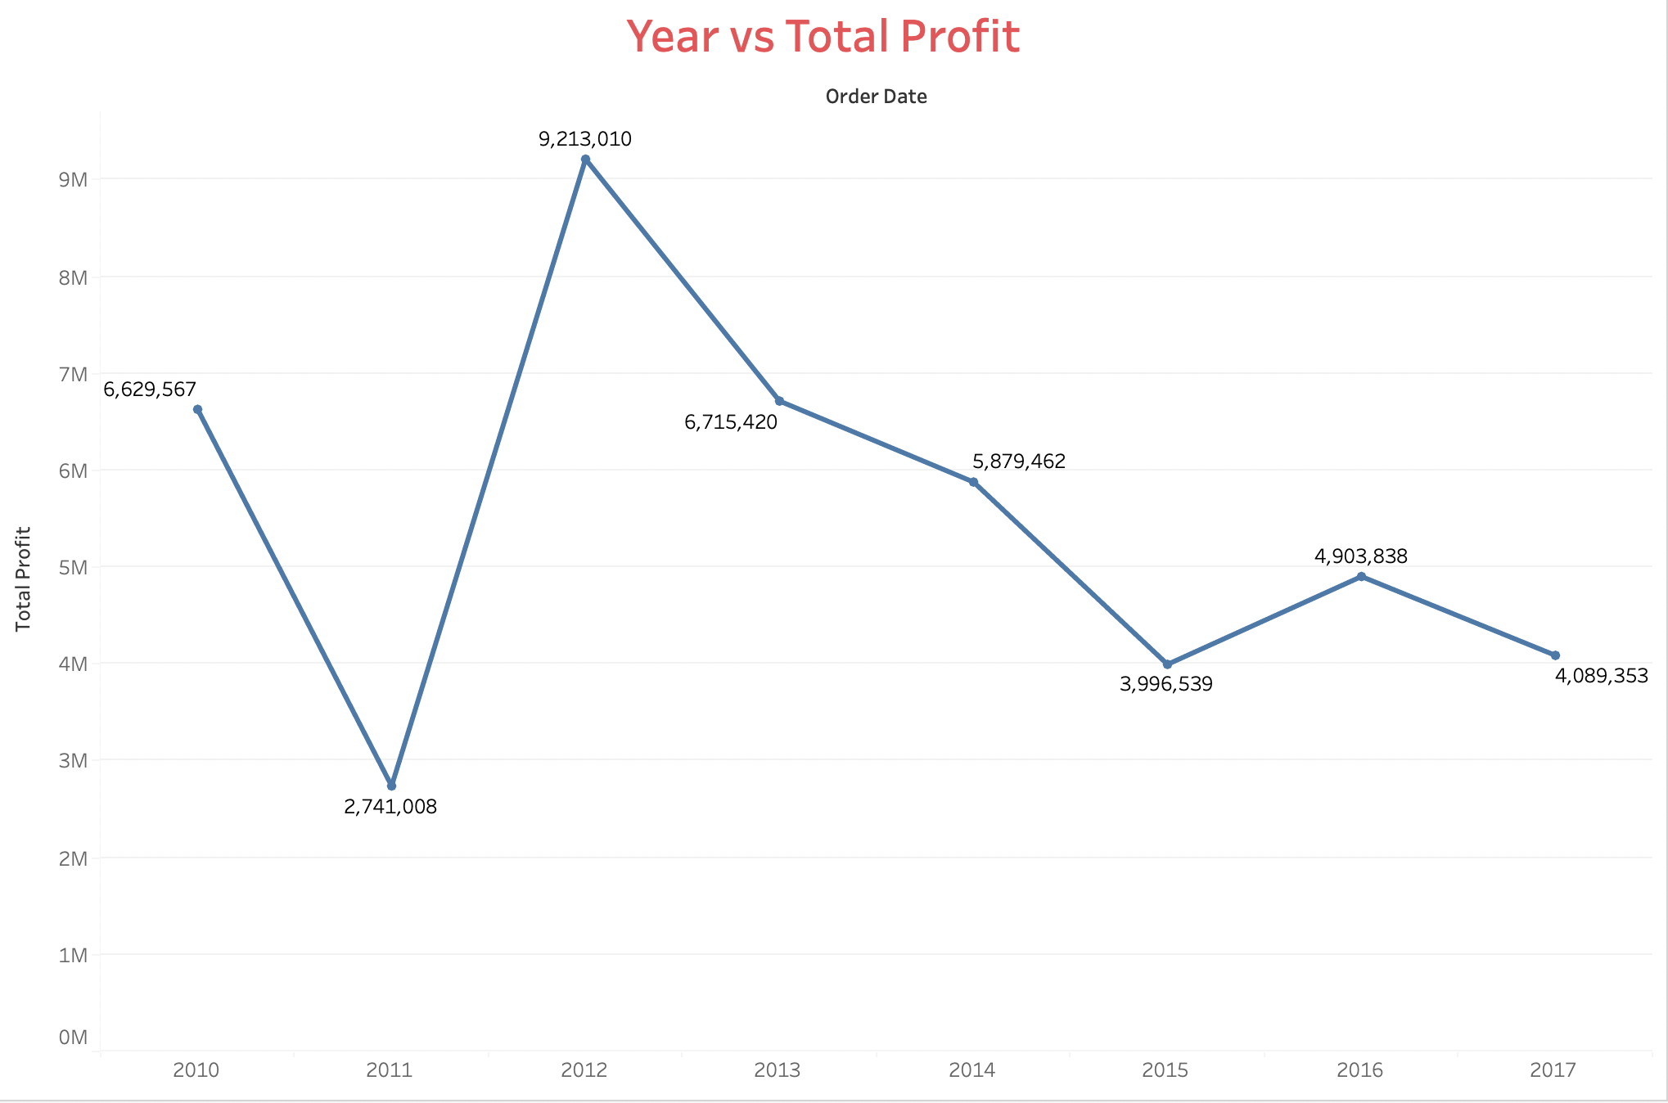
Insights
Sales Trend
Year Wise
Maximum Profit is seen for the year 2012
Profit mostly kept on decreasing after 2012

Slide 11
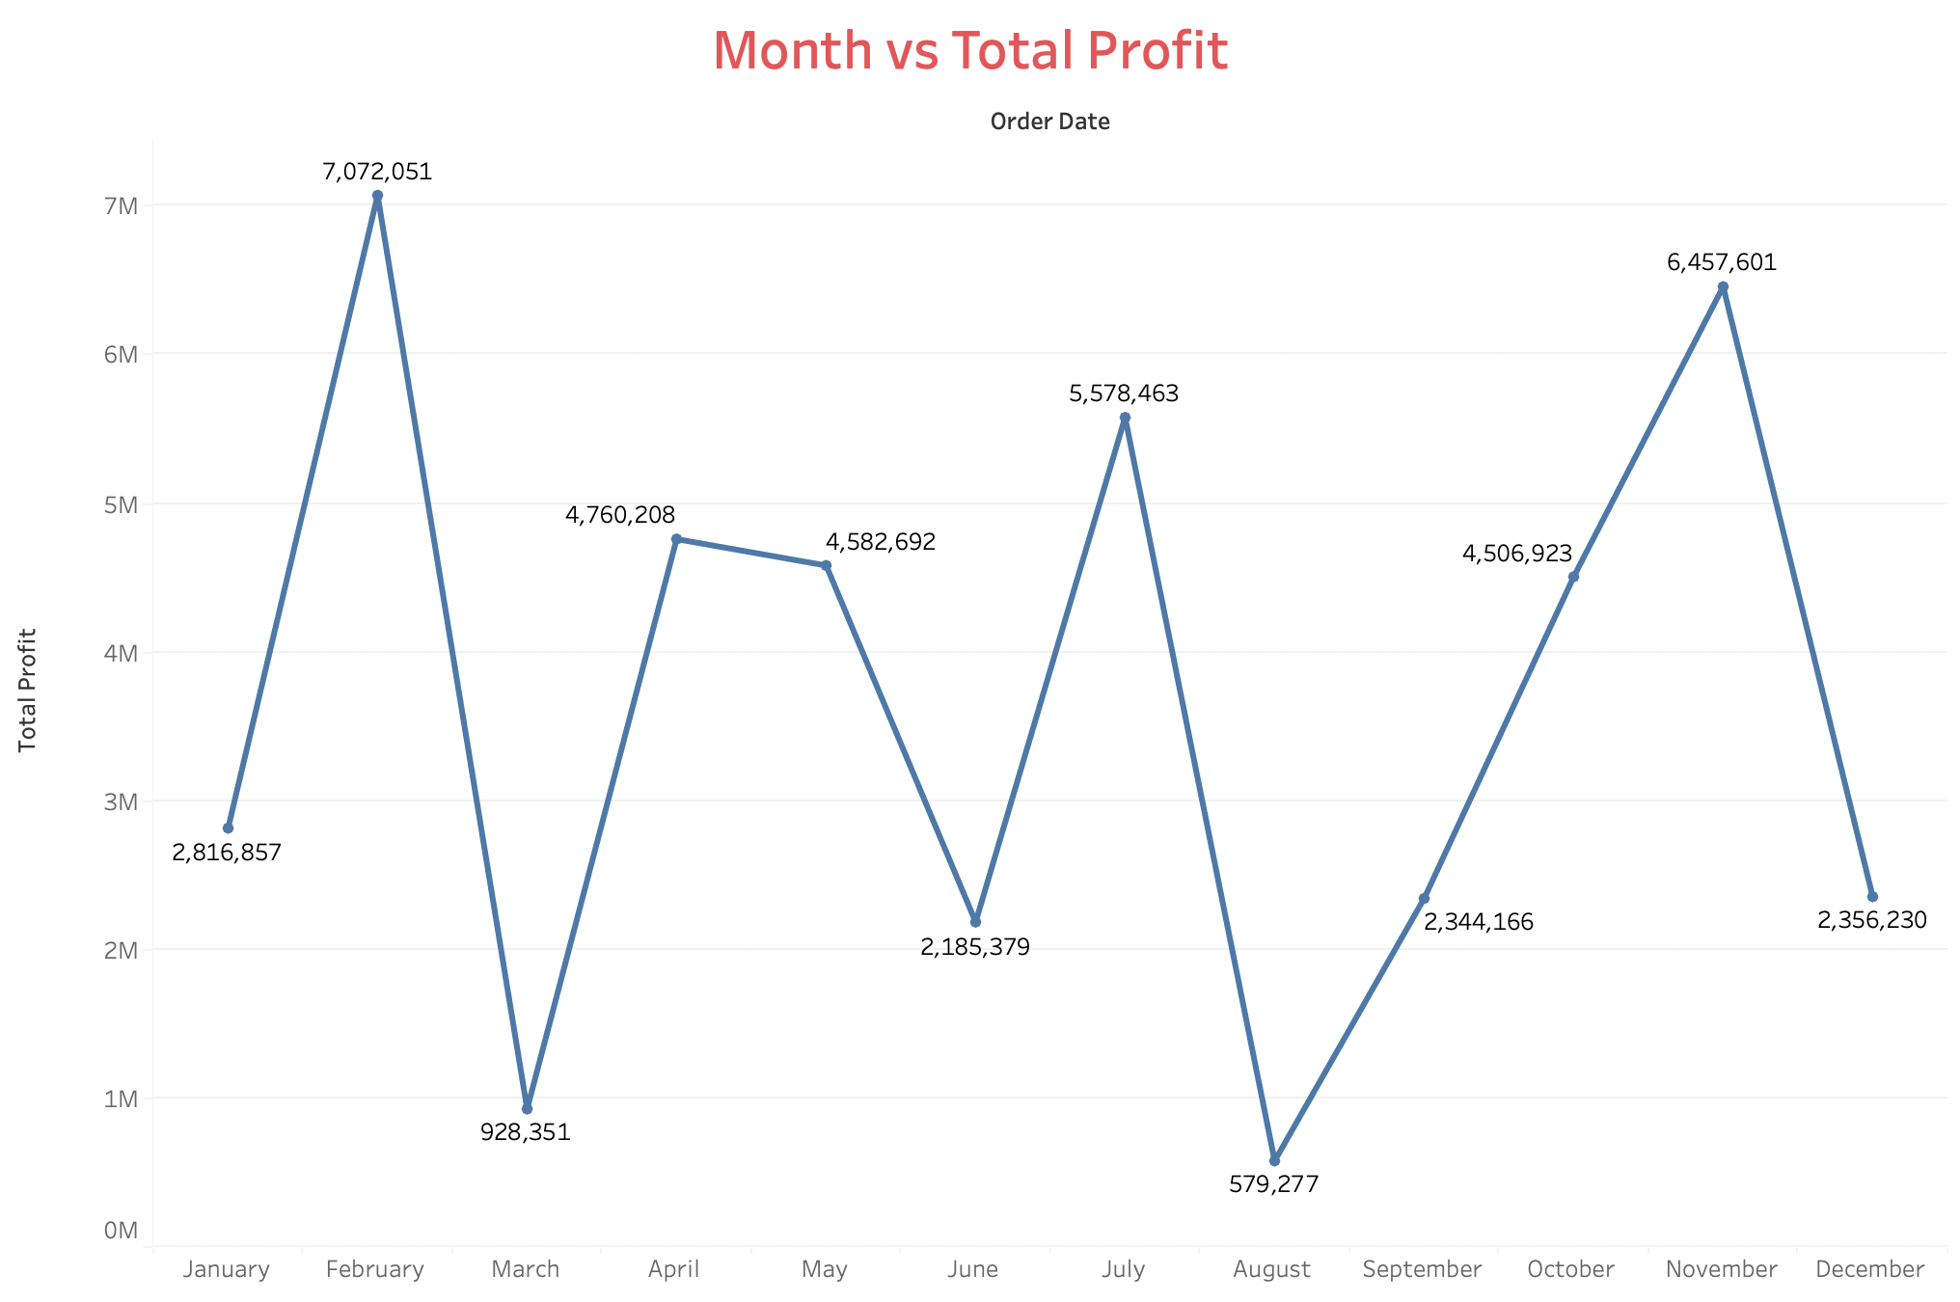
2. Sales Trend Month Wise
Most of the Total Profit is received for month Feb and Nov.
Least for Mar and Aug

Slide 12
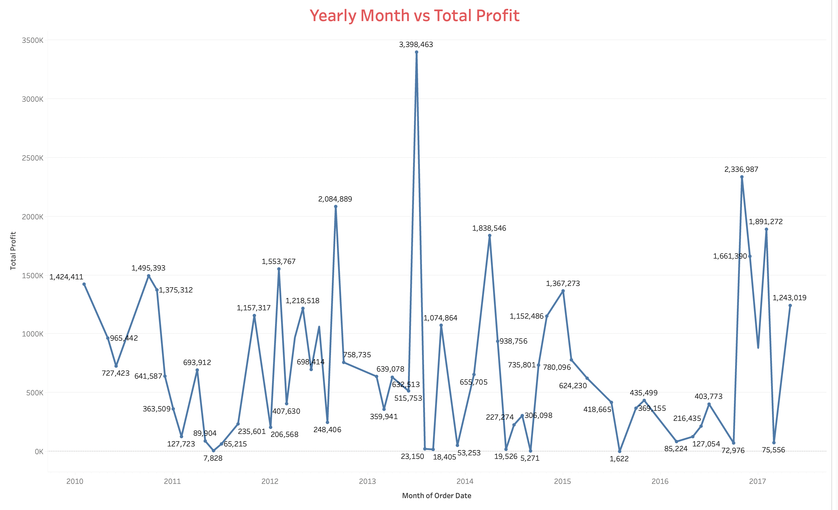
3. Sales Trend Yearly Month wise
We can observe a sharp peak between the year 2013 and 2014

Slide 13
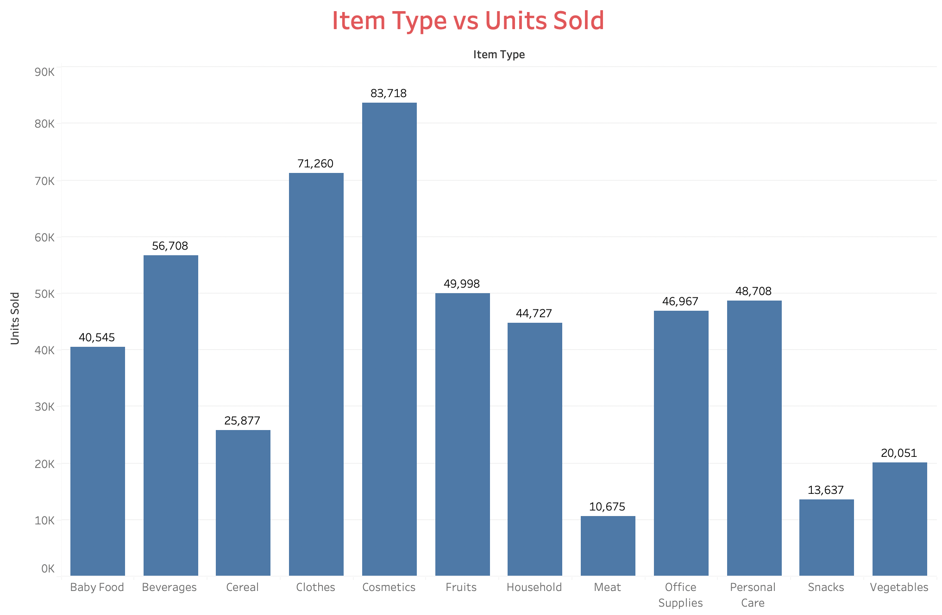
4. Item Type vs Units Sold
Most of the units are sold for items – Cosmetics and Clothes
And least for items- meat and snacks

Slide 14
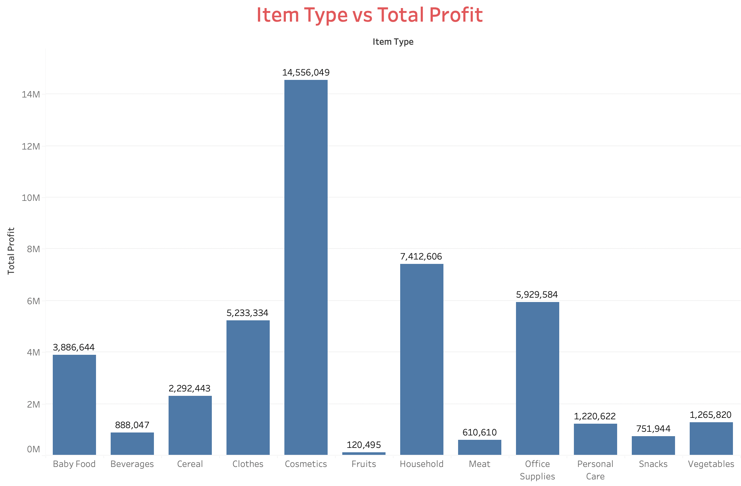
5. Item Type vs Total Profit
Profit of Cosmetics items is comparatively very high.
Least for Food Items such as Fruits, beverages etc.

Slide 15
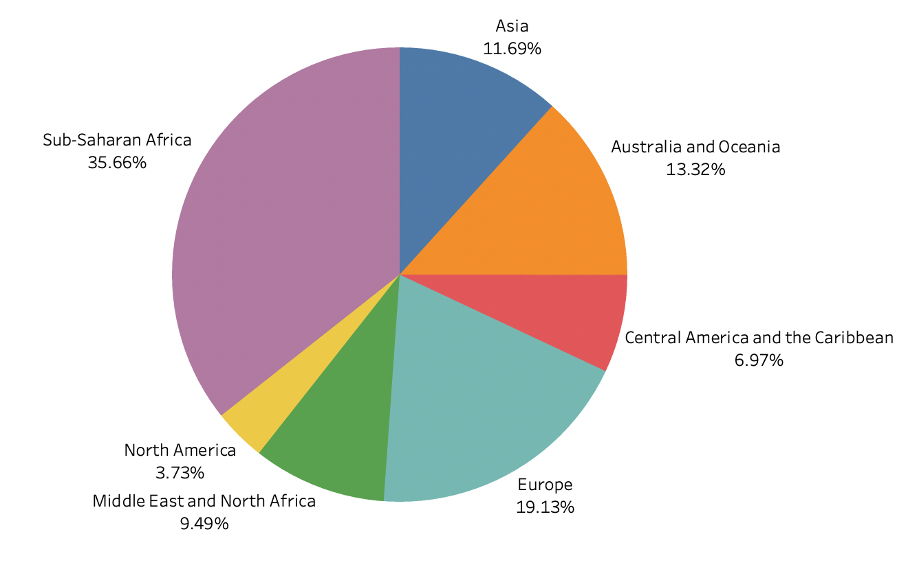
6. Region vs Count
Sub-Saharan Africa have most units Sold
Least can be seen in North America

Slide 16
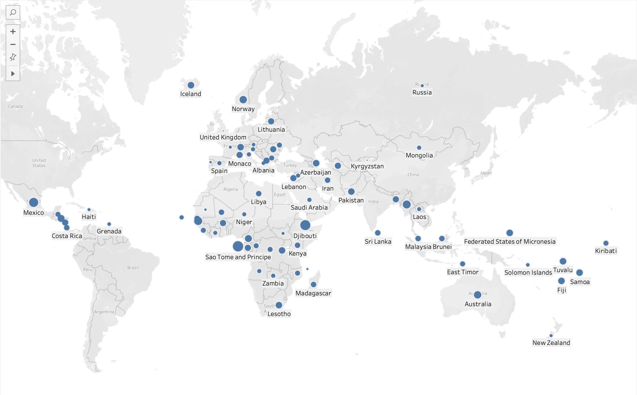
Units Sold in different countries

Slide 17
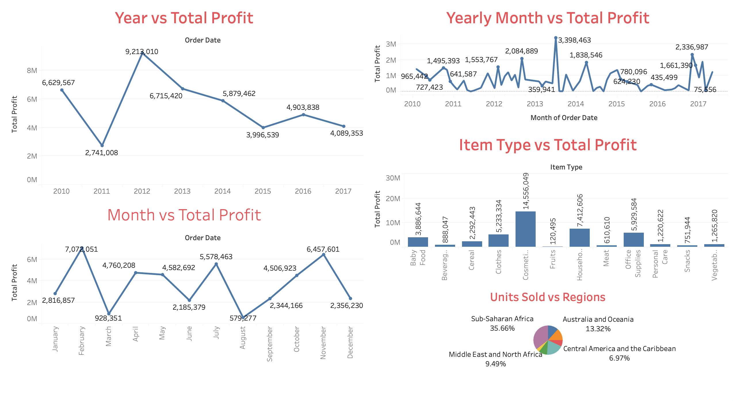
FINAL REPORT

Slide 18
KEY PERFORMANCE INDICATOR (KPI)
1. Unit Profit of Items
2. Units Sold by Items, regions
3. Total Profit by Year, Month, Yearly Months

Slide 19
CONCLUSION
Maximum total profit appears in months Feb and Nov , and least in Mar and Aug
The total profit is maximum for year 2012 and least in 2011
Most profitable item is cosmetics and least profitable are food items such as Fruits, beverages and meat.
Most of the item types are Clothes, Cosmetics and Office Supplies
The most units are sold in regions Sub-Saharan Africa (37) and Europe (24).
Most of the shipping is happening on Saturdays and Wednesdays and least on Sundays

Slide 20
Q & A
Q1) What’s the source of data?
Ans) The Dataset was taken from iNeuron’s Provided Project Description Document. https://drive.google.com/drive/folders/1FkmFVL8wlJmQWP1z52TD8PlhOJhitTyI?usp=s
Q2) What was the type of data?
Ans) The data was the combination of numerical and Categorical values.
Q 3) What’s the complete flow you followed in this Project?
Ans) Refer slide 5th for better Understanding
Q4) What techniques were you using for data?
Ans) - Removing unwanted attributes
- Univariate and Bivariate Analysis
- Adding necessary attributes

Slide 21
-Cleaning data and imputing if null values are present.
-Converting Mixed Date time formats into Pandas date type.
Q 6) What were the libraries that you used in Python?
Ans) I used Pandas, NumPy and Matplotlib and Seaborn libraries in Pandas

